Slide 1

VoIP UserAgent
SIP UserAgent written in Java
Maven Project - JavaFX Application
https://github.com/silversoft77/VoIP-UserAgent

Slide 2
What is it about?
User Agent VoIP
A User Agent is the fundamental element of the SIP protocol and allows the user to make calls using the IP protocol without a data transport connection.
SIP - Session Initiation Protocol
It is a text-based application-level protocol used to create, modify, or terminate sessions (such as VoIP sessions) between multiple participants. By default, it uses the UDP protocol.

Slide 3
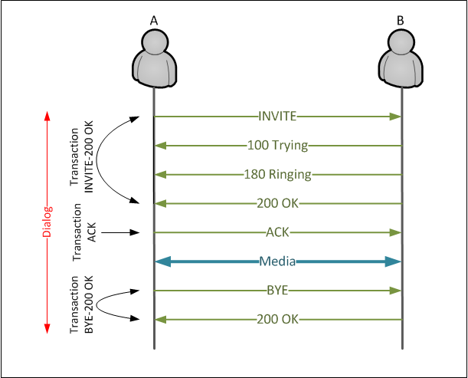
SIP Session
SIP Requests
INVITE
used to initiate a VoIP session with the other party (the callee)
may include media description via SDP
ACK
confirms receipt of a final response to a previous INVITE request
BYE
terminates a connection

Slide 4
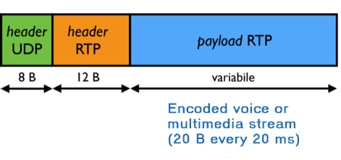
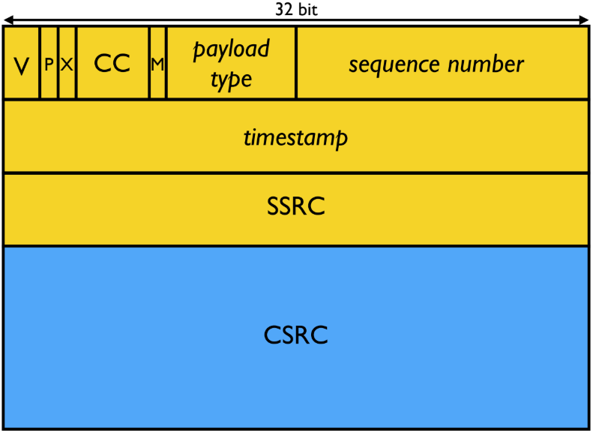
RTP Session
Real-time Transmission Protocol
End-to-end transport protocol for real-time applications, typically used over UDP. It does not establish sessions and can be used to transport any type of media or codec.
Header

Slide 5
RTP Session
Real-time Transmission Protocol
End-to-end transport protocol for real-time applications, typically used over UDP. It does not establish sessions and can be used to transport any media or codec.
Audio Format
Sample Rate: 8000 Hz
Sample Size: 8 bit
Channel: 1
Packet Size: 8000 * 20 / 1000 = 160 bytes
Packet time: 20ms
Encoding: ULAW

Slide 6
Diagrams
A high-level overview of the completed project

Slide 7
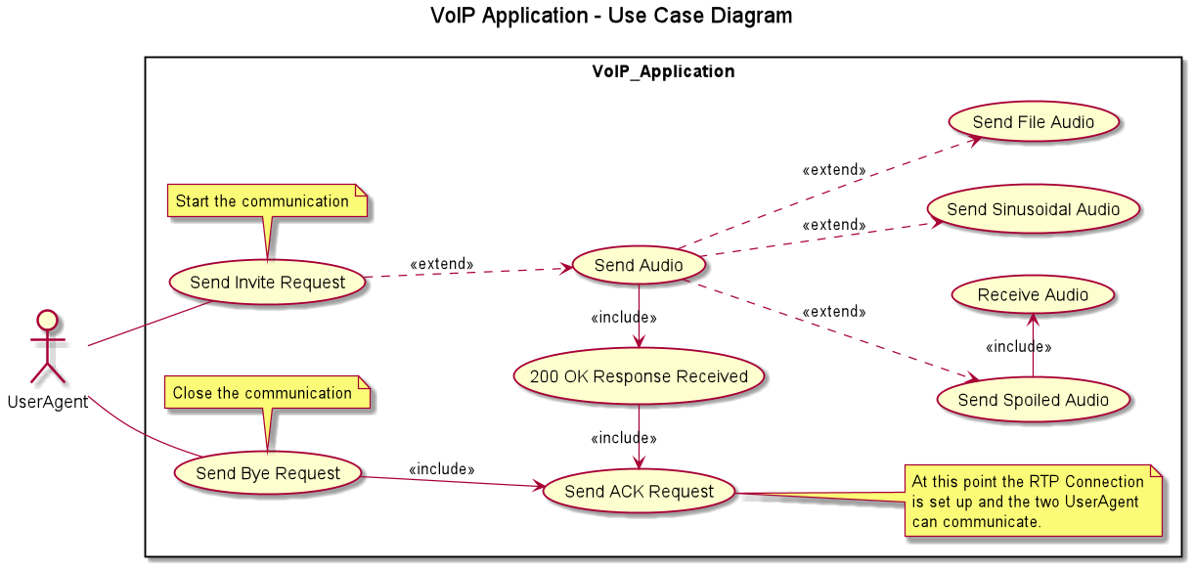
Application - Use Case Diagram

Slide 8
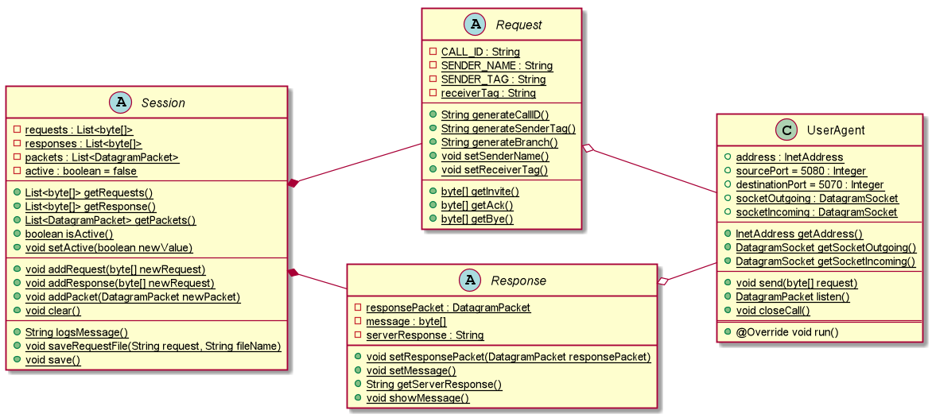
SIP - Class Diagram

Slide 9
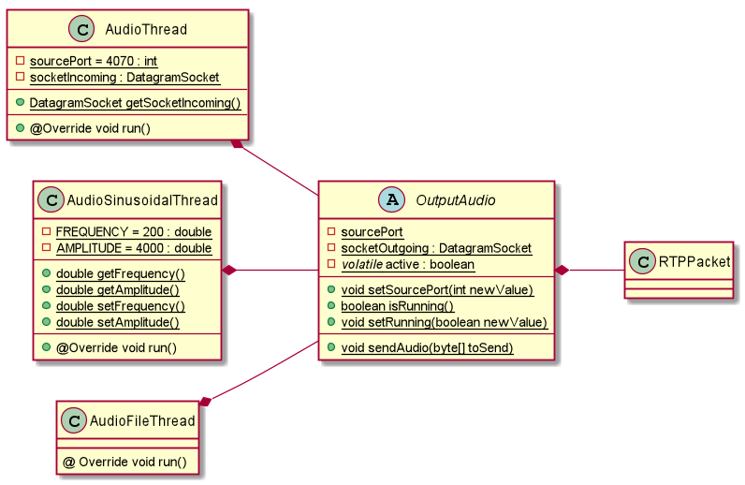
RTP - Class Diagram

Slide 10
User Interface

Slide 11
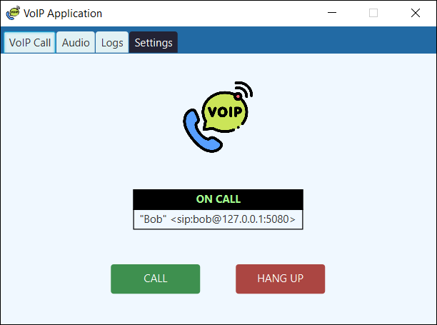
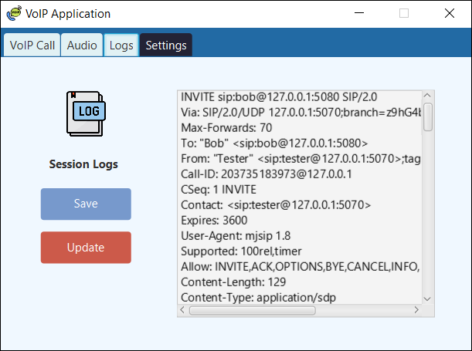
GUI
Main window through which it’s possible to start the call.
The black label provides information on the call’s status.
Displays the session logs. The Update button allows you to refresh the content of the textbox, while the Save button lets you save the content to src/main/resources/requests

Slide 12
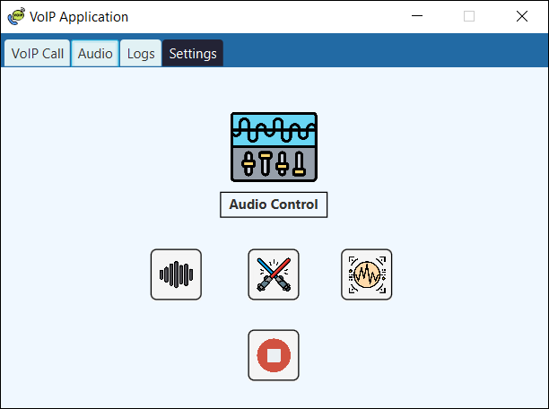
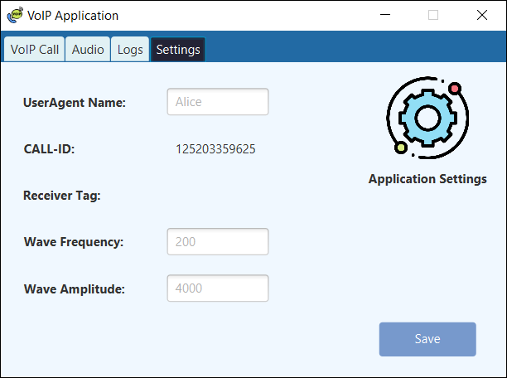
GUI
Window for sending RTP packets. The first three buttons represent different audio transmission modes, while the button below allows you to stop the transmission.
Settings page. Through this page, the user can view the session's IDs and tags, and change certain parameters such as their name and some sinusoidal wave settings.

Slide 13
Let's get technical
The structure of the classes

Slide 14
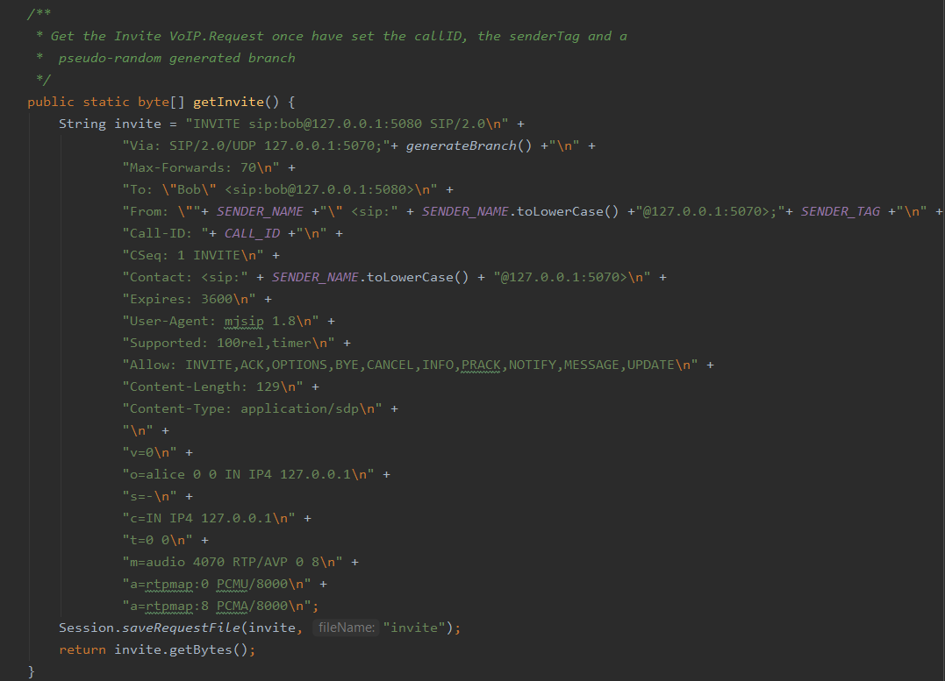
INVITE REQUEST
+
SDP
src/main/java/VoIP/Request.java

Slide 15
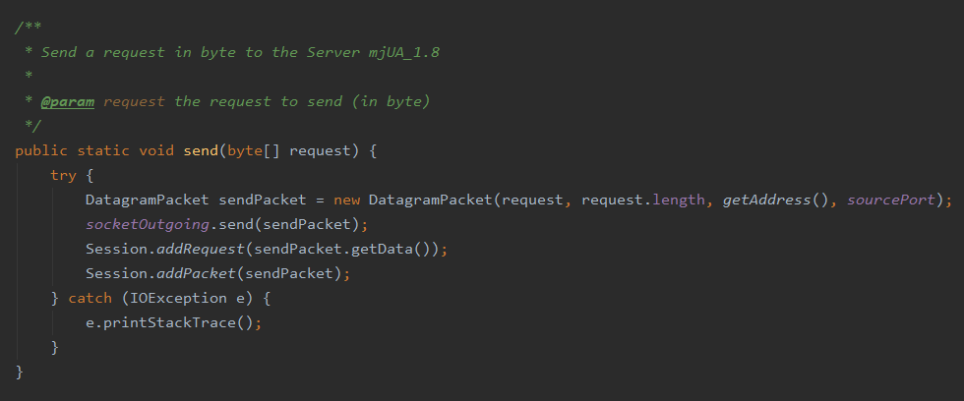
src/main/java/VoIP/UserAgent.java

Slide 16
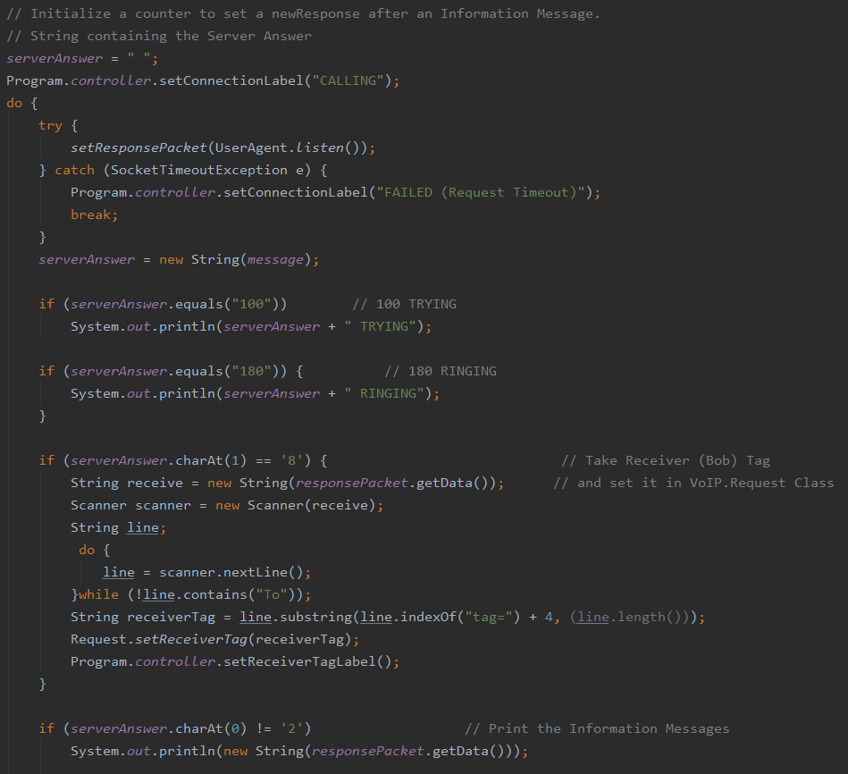
src/main/java/VoIP/Response.java
RECEIVE RESPONSE

Slide 17
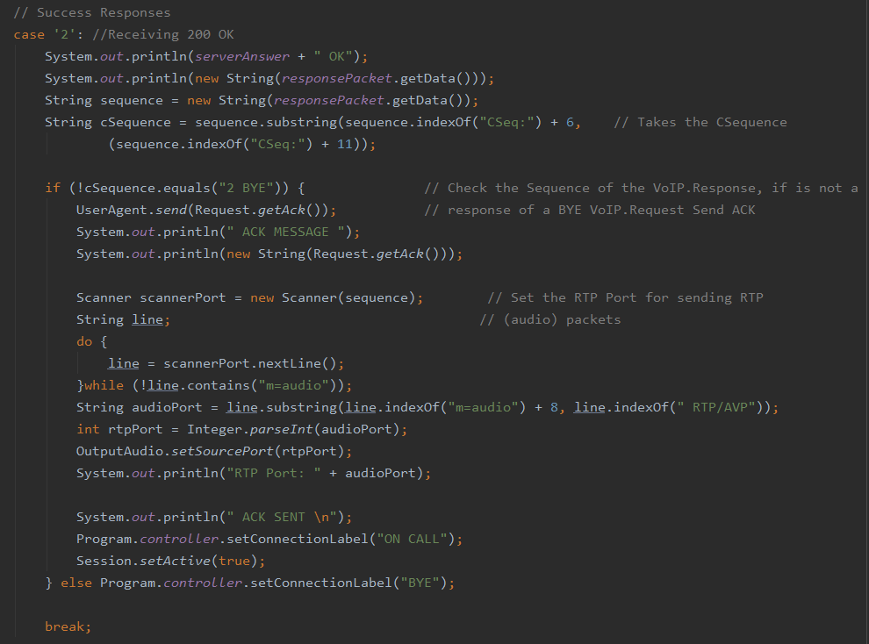
src/main/java/VoIP/Response.java
RECEIVE RESPONSE

Slide 18
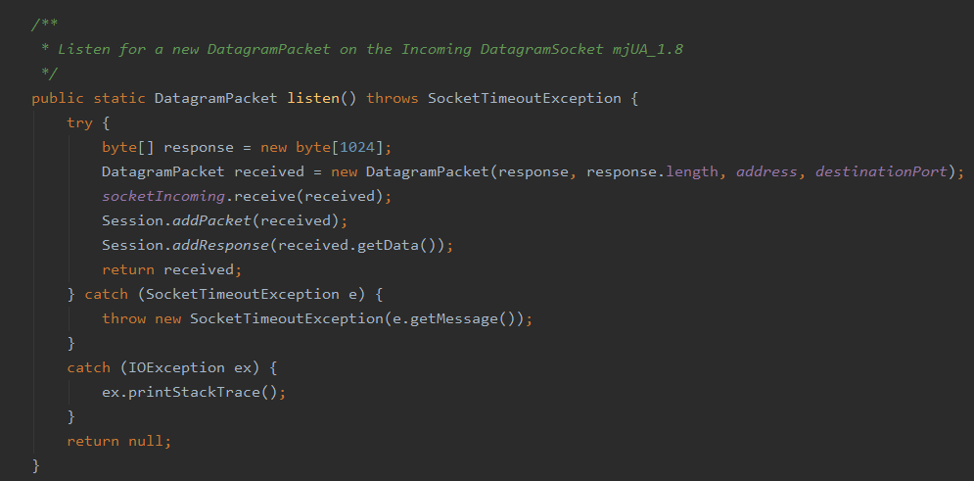
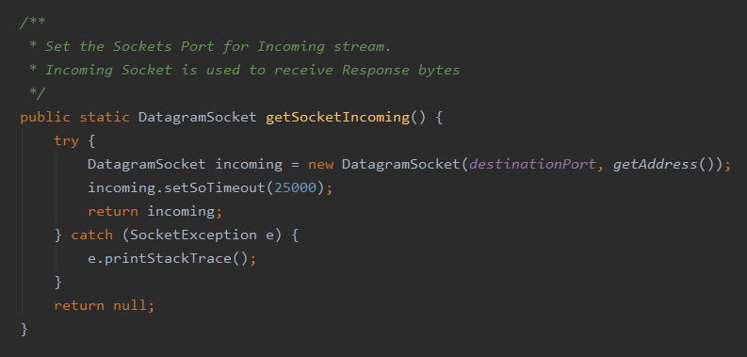
Socket Timeout Exception
src/main/java/VoIP/UserAgent.java

Slide 19
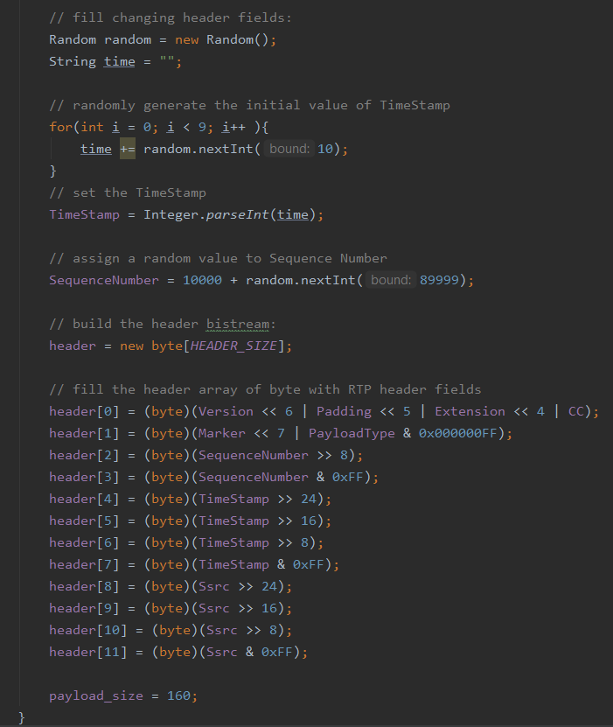
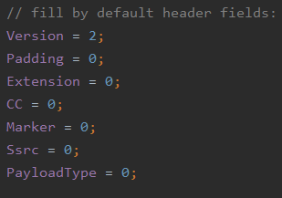
RTP Packet Class
src/main/java/Audio/RTPPacket.java

Slide 20
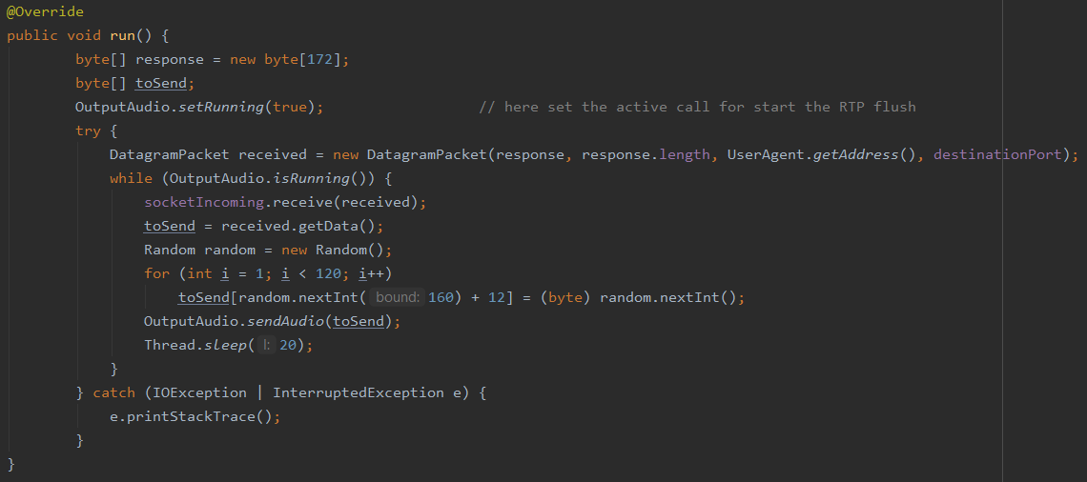
AudioThread Class - Send Spoiled Audio
src/main/java/Audio/AudioThread.java

Slide 21
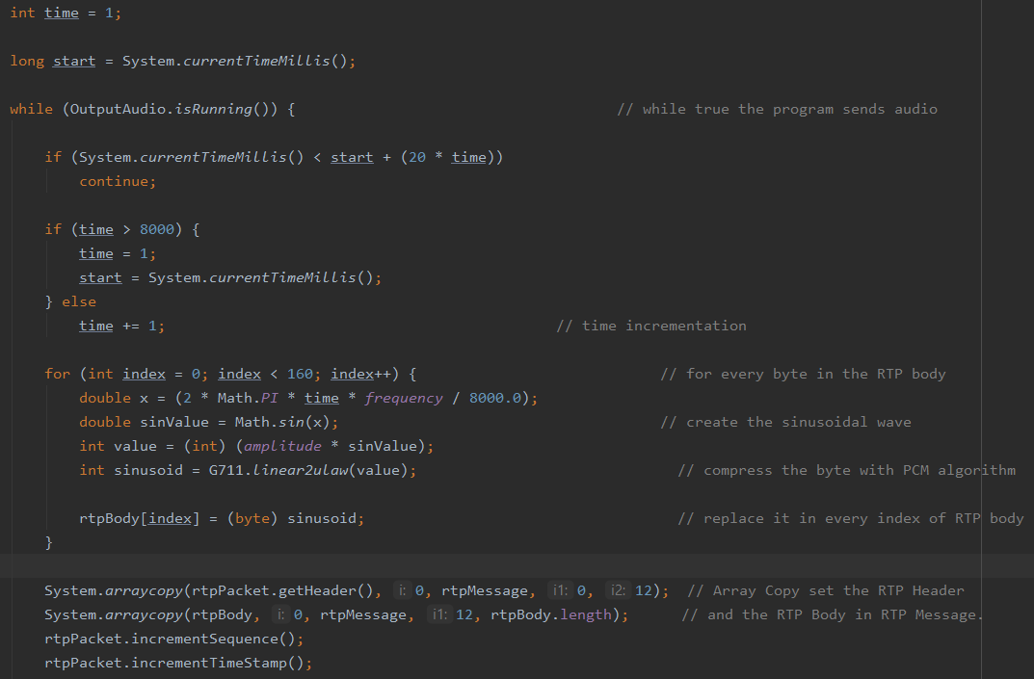
AudioSinusoidalThread Class - Send Sinusoidal Audio
src/main/java/Audio/AudioSinusoidalThread.java

Slide 22
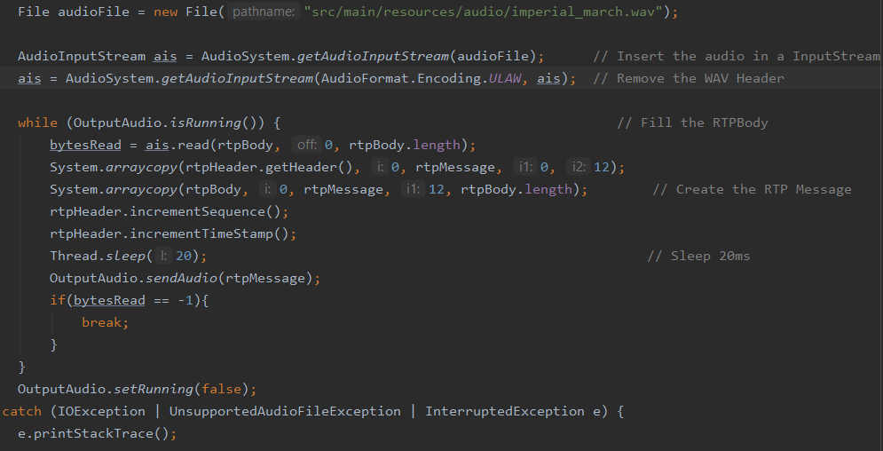
AudioFileThread Class - Send File Audio
src/main/java/Audio/AudioFileThread.java

